Slide 1
What AI Is Doing to Student Thinking and What Educators Can Do About It
Dr. Victoria Livingstone
Jeppe Klitgaard Stricker
03 November 2025

Slide 2
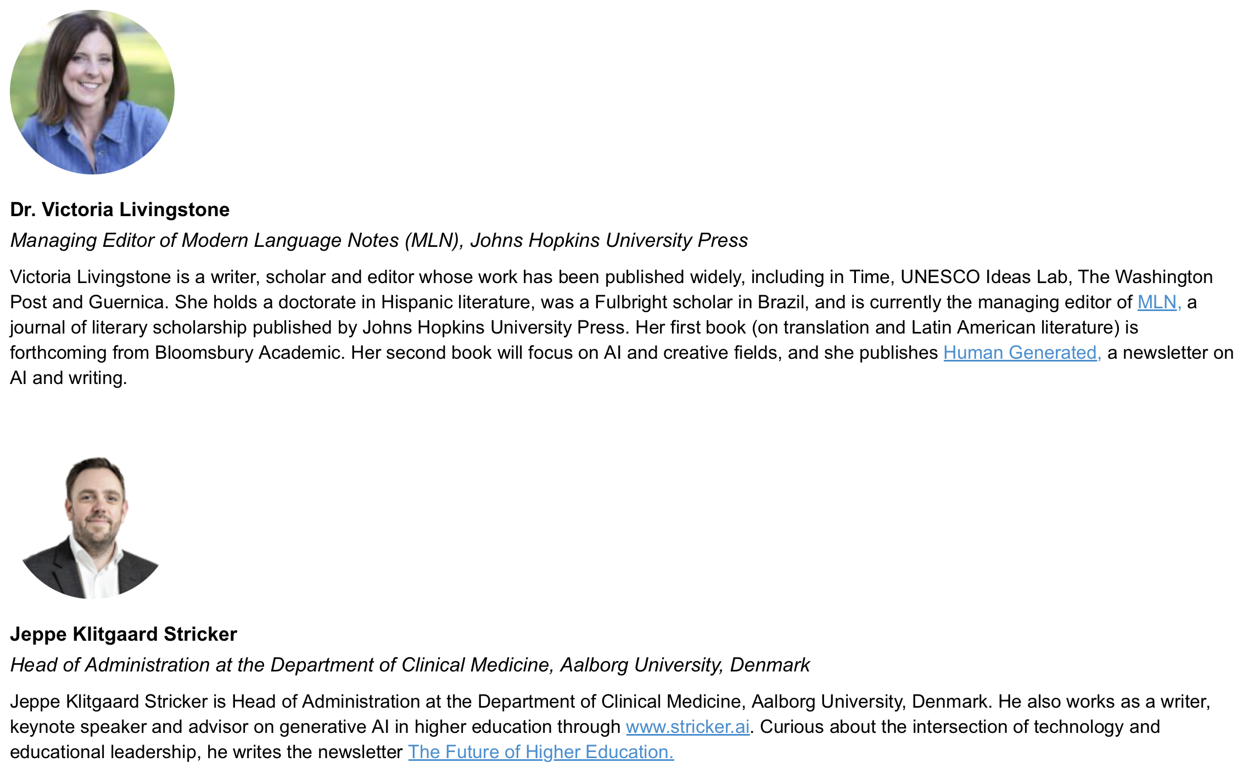
What AI Is Doing to Student Thinking and What Educators Can Do About It
Contact North
3 November, 2025
Jeppe Klitgaard Stricker

Slide 3
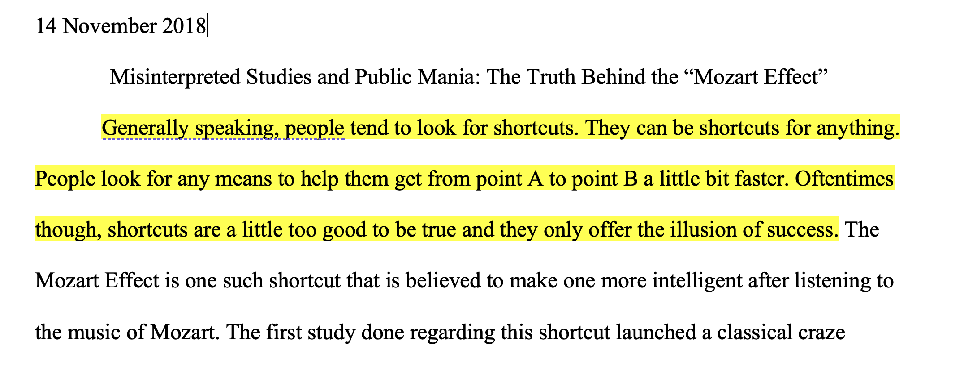

Slide 4
Students struggled to formulate research questions:
Summary: “The technology behind prosthetic limbs has advanced”
Ethical or unanswerable questions: “Cosmetic surgery is immoral.”
Beginning with an answer: “A vegan diet improves health”
Questions with too broad a scope: “Was the assassination of Archduke Franz Ferdinand really the cause of World War 1?”

Slide 5
Techniques for research question formulation
Discussions with peers, librarians, and professors
Reading and annotating texts
Following bibliographic trails
Freewriting
Unplugging, walking, etc.
Chatbots?

Slide 6

Topic→ Question
Music →
Cognition →
The Mozart Effect →
Why did the myth persist? And what are the effects of the prevalence of this idea in popular culture?

Slide 7
Cognitive Friction
Cognitive friction: “the resistance encountered by a human intellect when it engages with a complex system of rules that change as the problem permutes.”– Alan Cooper (software designer)

Slide 8
Towards Frictionless Education

Slide 9
Towards Frictionless Education
Assumption:
The struggle to find sources, evaluate contradictory evidence, and refine questions is the learning—not just annoying steps toward it

Slide 10
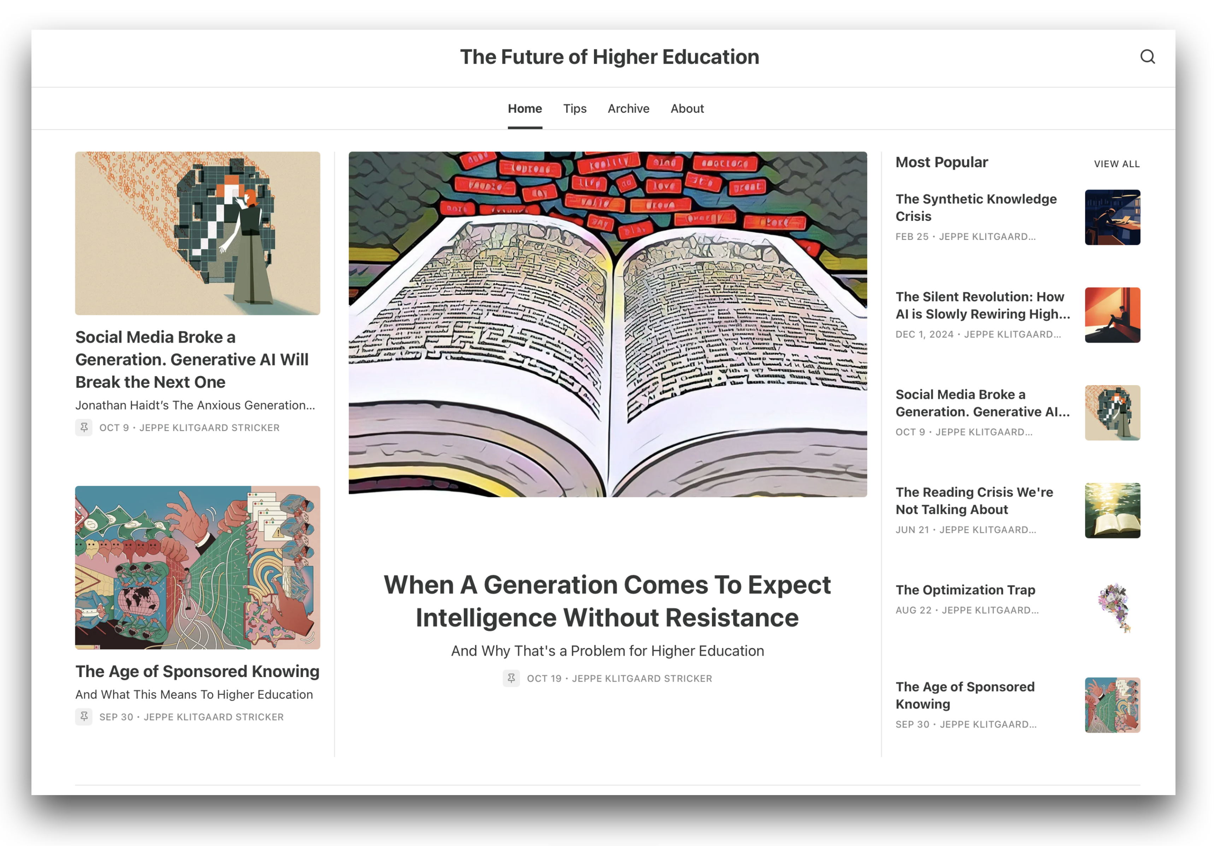

Slide 11
Towards Frictionless Education
Psychology and UX implications
Speed and instant gratification (sycophantic UX, dopamine rush)
Platform stickiness—iterative loops risk replacing deeper forms of cognitive engagement
Communication patterns and (academic) identity building—a kind of intellectual mirroring that starts in casual conversation before seeping into academic discourse

Slide 12
Towards Frictionless Education
The current situation
AI-enhanced learning may enable students to bypass the slow work of reading, evaluating, and synthesizing that build expertise
Generative AI instead of search (Perplexity Comet, OpenAI Atlas, etc.). Where does this leave Google, books, academic papers, etc.?
The role of ambiguity is challenged →

Slide 13
Towards Frictionless Education
Students forming habits through frictionless systems arrive expecting instant resolution, interpreting appropriate intellectual resistance as unreasonable obstacles
Real intellectual communities push back against poorly developed ideas and weed out weak thinking. These responses shape behavior and thinking.
AI typically doesn’t push back on weak thinking, vague questions, or minimal effort

Slide 14
The Prompt Problem / The Unclear Question
AI delivers output—but students learn more from wrestling with unclear problems
Students may stop asking questions if the feedback always feels the same, regardless of the question posed (quality, complexity, etc.)
Over time, better prompts resulting in better output gets conflated with better thinking

Slide 15
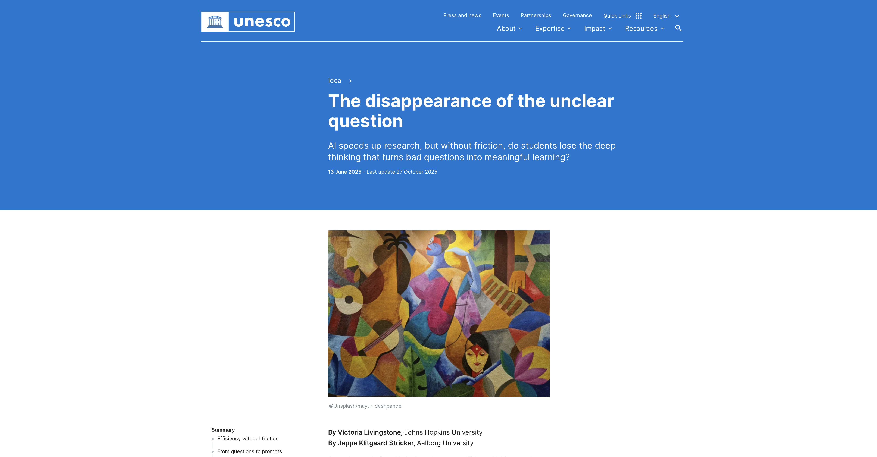

Slide 16
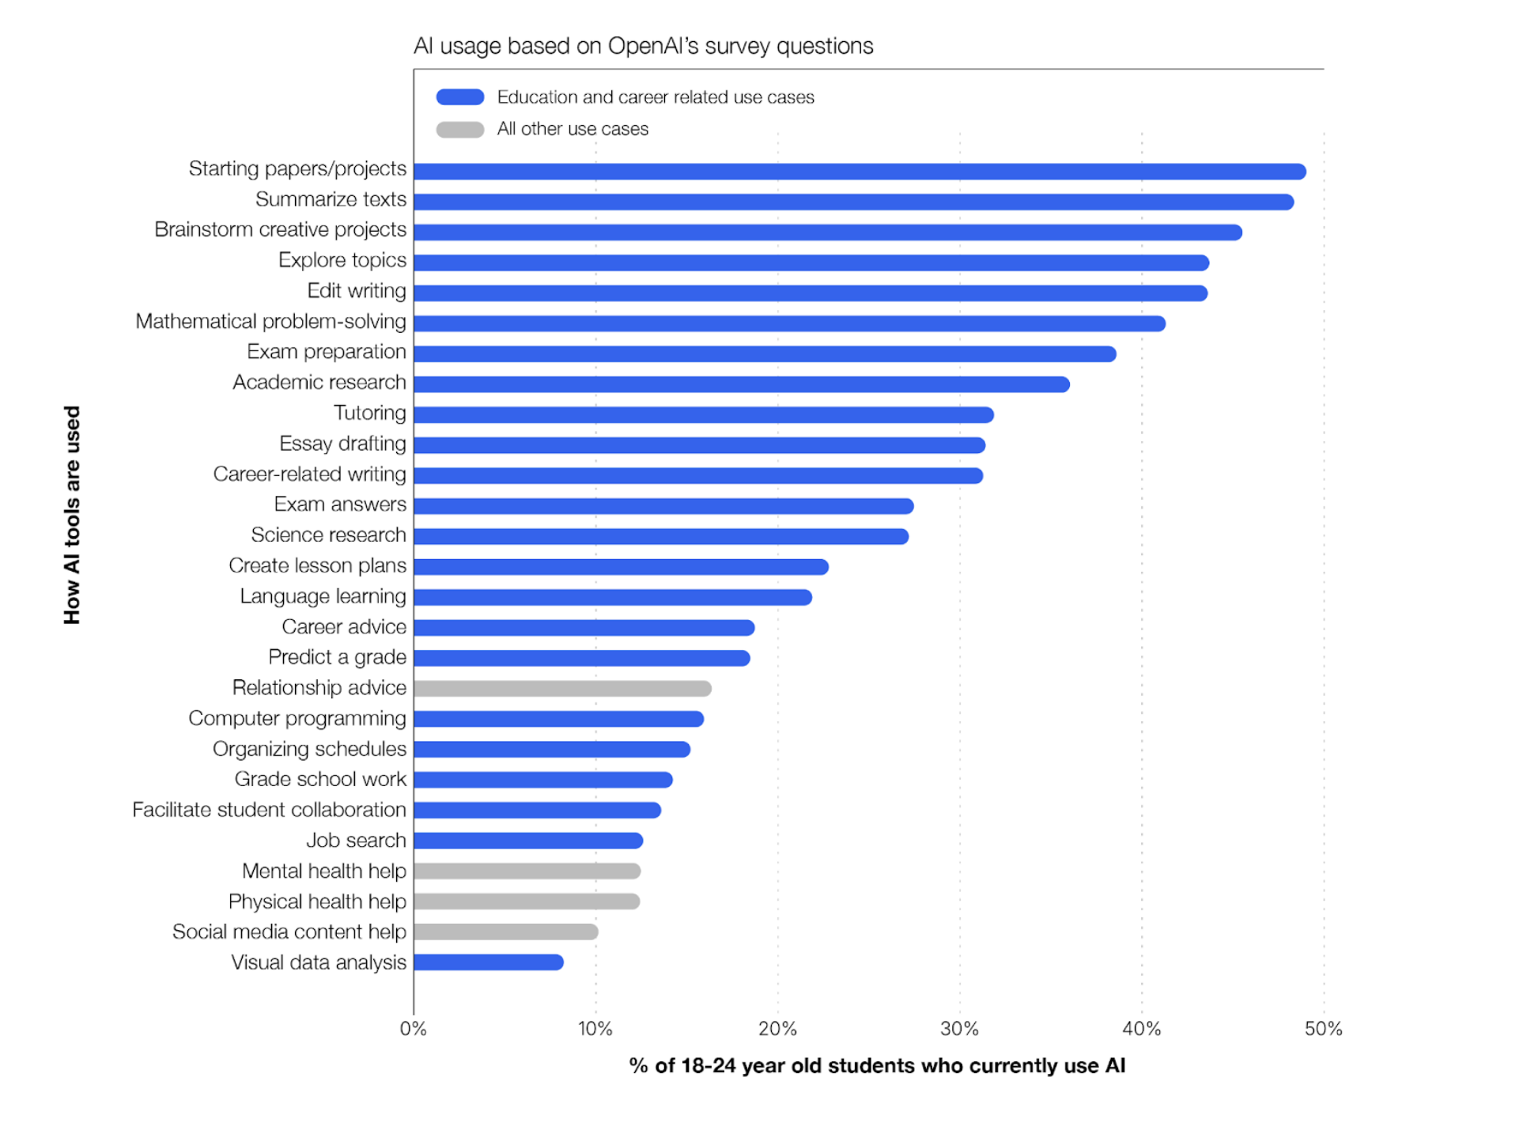

Slide 17

The emperor has no clothes! No one has a solution (yet)
2024– the tech has evolved since then
AI use by students is almost certainly underreported
Instructors tend not to report students
AI detectors are faulty
Blanket policies are ineffective

Slide 18
Narrowing research questions with ChatGPT
Prompt: Help me find a research question on music and the brain
ChatGPT 5 offered categories followed by specific questions
  Cognition and Learning
  Emotion and Reward Systems: Does musical exposure before age 5 lead to measurable differences in language lateralization in the brain?
  Neuroplasticity & Development
  Clinical & Therapeutic Applications
  Neuroscience of Musical Creativity

Slide 19
Does musical exposure before age 5 lead to measurable differences in language lateralization in the brain?
(You can narrow further: “...as measured by a language-evoked lateralization index from fNIRS/EEG and by structural connectivity (DTI) of language-related tracts.”)
Research Question (Undergraduate level): Does being exposed to music before age 5 change the way the brain processes language, especially which side of the brain is more active?

Slide 20
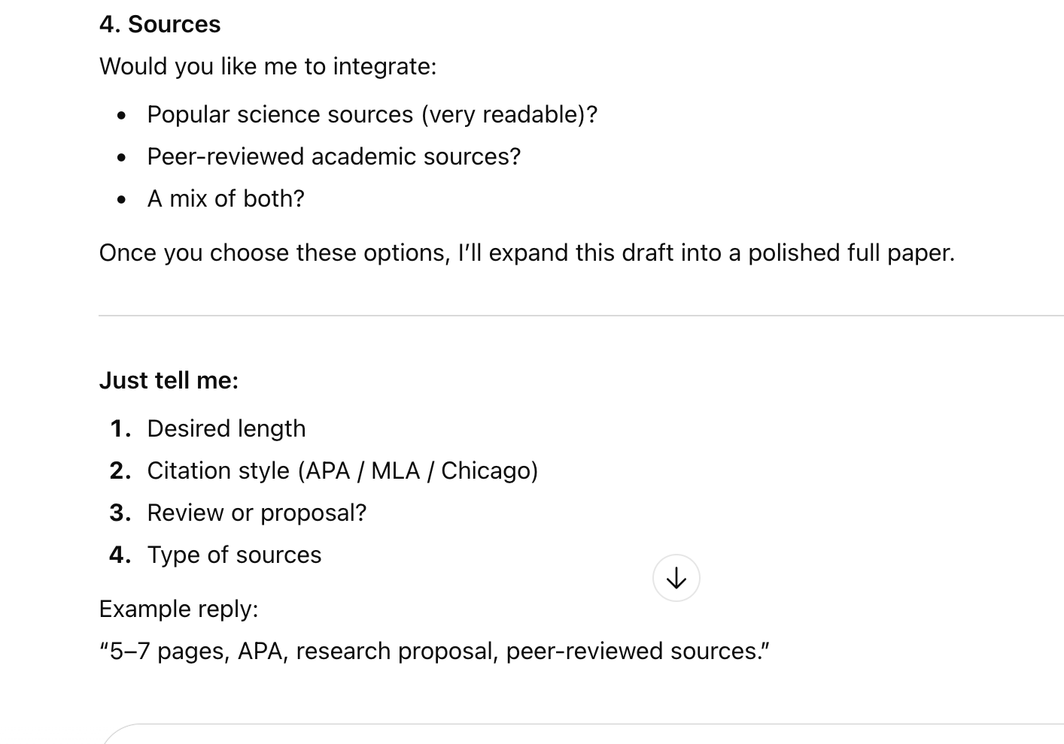
Highly technical terms that may not be familiar to an undergraduate
No opportunity for exploration
Broad → hyperspecific
Sycophantic
It immediately offers to begin drafting

Slide 21
Do LLMs have a place in an undergraduate writing class?

Slide 22
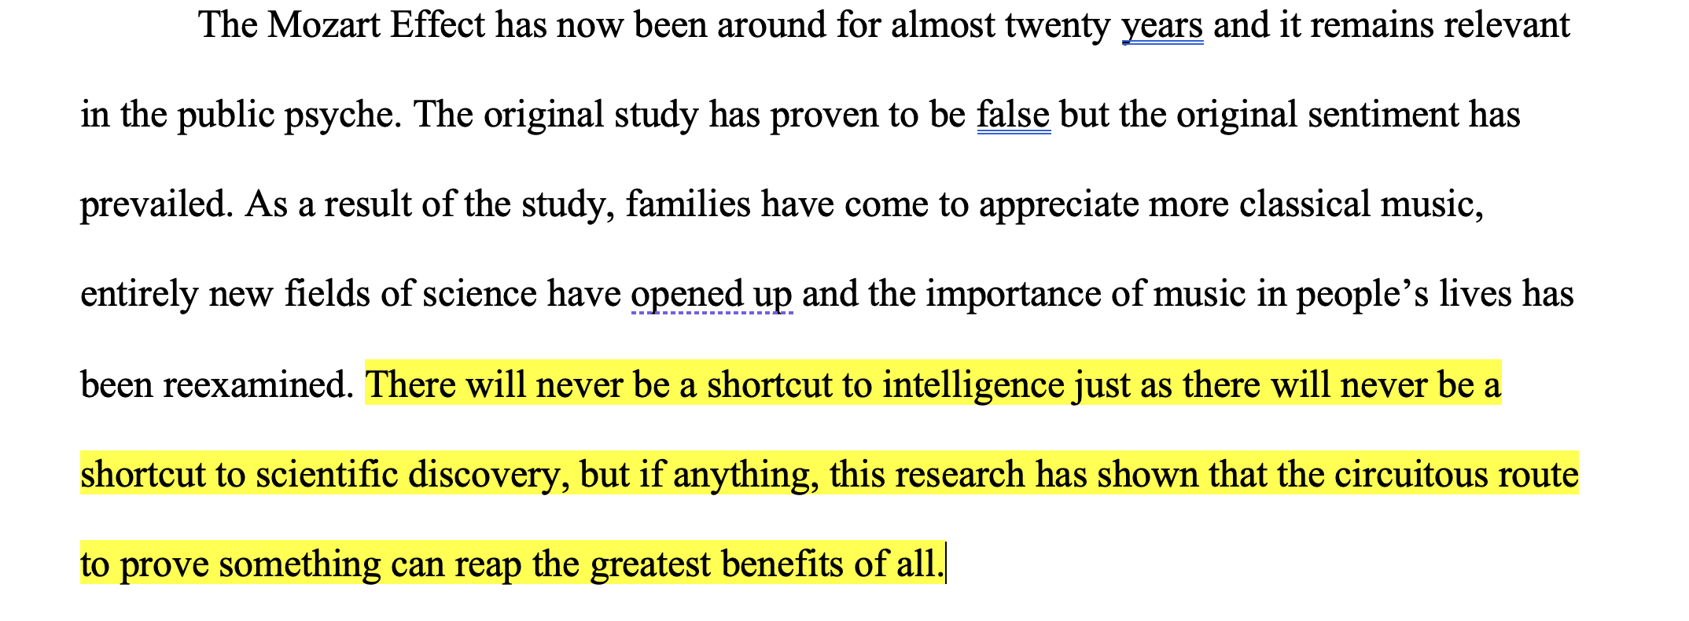

Slide 23



Slide 24
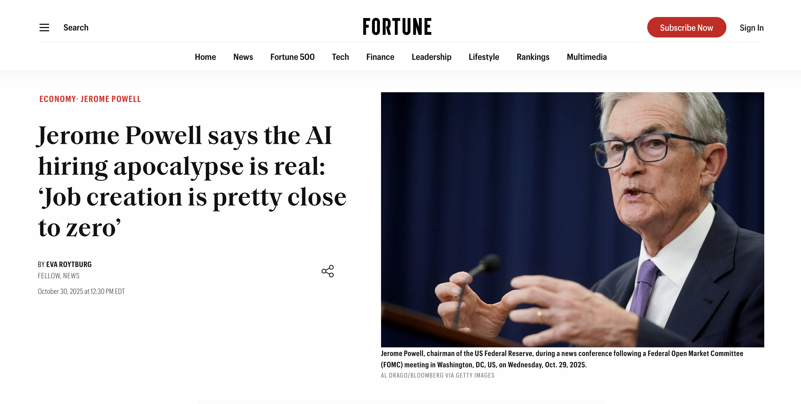

Slide 25
What’s the problem?
Education is a highly interconnected system.
If we change one part (e.g., assessment), others - policy, pedagogy, curriculum, IT, professional development, etc. - must follow.

Slide 26


Slide 27
What’s the (wicked) problem?
There's no definitive formulation of the problem itself

Slide 28
What’s the (wicked) problem?
There's no definitive formulation of the problem itself
Every solution attempt changes the problem

Slide 29
What’s the (wicked) problem?
There's no definitive formulation of the problem itself
Every solution attempt changes the problem
We can't "solve" AI in education and move on

Slide 30
What’s the (wicked) problem?
There's no definitive formulation of the problem itself
Every solution attempt changes the problem
We can't "solve" AI in education and move on
We rush to premature solutions

Slide 31
What’s the (wicked) problem?
There's no definitive formulation of the problem itself
Every solution attempt changes the problem
We can't "solve" AI in education and move on
We rush to premature solutions
Fragmented responses

Slide 32
What’s the (wicked) problem?
There's no definitive formulation of the problem itself
Every solution attempt changes the problem
We can't "solve" AI in education and move on
We rush to premature solutions
Fragmented responses
We confuse efficiency with effectiveness

Slide 33
What’s the (wicked) problem?
There's no definitive formulation of the problem itself
Every solution attempt changes the problem
We can't "solve" AI in education and move on
We rush to premature solutions
Fragmented responses
We confuse efficiency with effectiveness
Institutional time vs. market timescales

Slide 34


Slide 35
Imperfect solutions
Oral exams
Collaborative approaches—students and faculty learn together
Requiring modules (or courses?) to teach AI literacy
Scaffolding assignments
AI-proof prompts (e.g. tasks specific to class discussions)
In-class writing
Rethinking assessment
Stop anthropomorphizing AI

Slide 36
What is the purpose of education?
And who gets to decide?
  Students
  Universities
  Ed tech
  Employers
  ?

Slide 37
Assessment
Why, exactly, do we assess student work?
Let’s forget about “AI-proofing” courses
There is no “generative AI in education”. We must consider specific subjects, curriculum, assessments, etc. - case by case

Slide 38
Assessment
We can't solve this comprehensively.
But we can be intentional about:
Naming what we're defending (and why it matters)
Designing for capacities/skills/values we want (not against tools we fear)

Slide 39
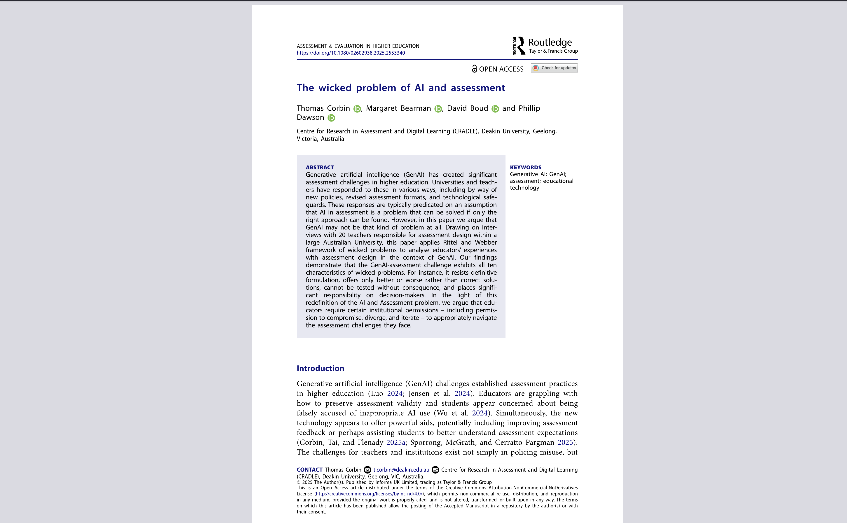

Slide 40
Conclusion: The solutions, then, are not simply modifying class activities (although this is important), but also:
  Collective action
  Changing assessment
  Teachers reclaiming agency
  Redefining the purpose of education
  Communicating with students regarding the goals of education (if education is just credentialing, we will not solve this problem)

Slide 41
